Slide 1
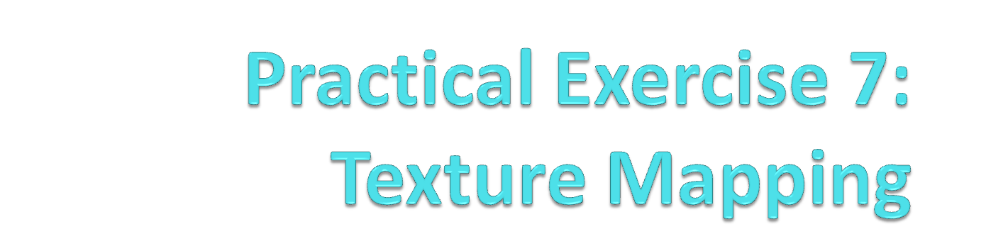
BACS 2173 Graphic Programming
[TOTAL : 25 marks]

Slide 2
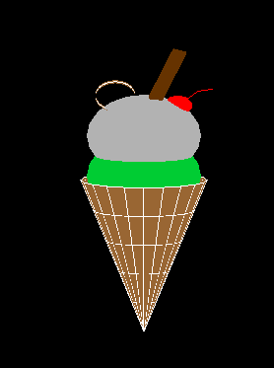
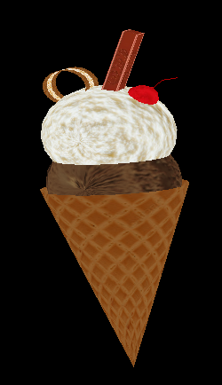
Exercise Q3
Let’s texture the ice- cream with at least 4 textures!
gluQuadricTexture(GLUquadric* quad, GLboolean texture);
(4 marks)

Slide 3
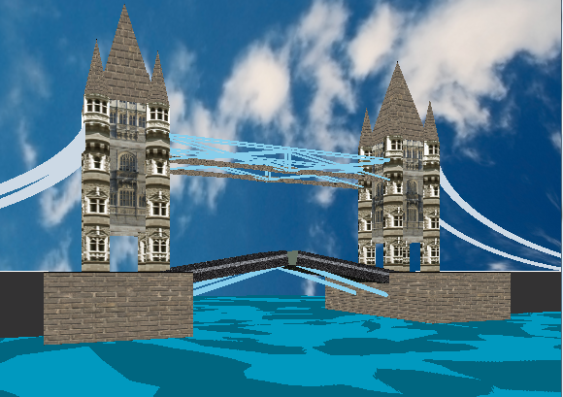
Exercise Q4
Put in texture for the London bridge to make it look realistic!

Slide 4
Exercise Q4
Criterias | Marks
Tower texture | 4
Base texture | 2
Top texture | 2
Bridge / road texture | 2
Background texture | 2
TOTAL | 12

